Slide 1
Machine Learning for data science and business intelligence – 8IAR403
By Kévin Bouchard Ph.D.
Professor in artificial intelligence & machine learning
Laboratoire d'Intelligence Ambiante pour la reconnaissance d'activités (LIARA)
Université du Québec à Chicoutimi
www.Kevin-Bouchard.ca

Slide 2



Summary of lesson #10
You will learn about:
Main evaluation metrics for classification
Strengths and weaknesses for each of them
How to extend them to multiple classes
How to perform the tests on your data

Slide 3
Introduction
Regression in machine learning is a type of predictive modeling technique which is used to find the relationship between a dependent variable (often called the 'target') and one or more independent variables (referred to as 'features' or 'predictors’)
The goal is to predict continuous outcomes as opposed to classification, which is used to predict categorical outcomes
Allows to:
Predict trends
Validate relationships between several variables

Slide 4
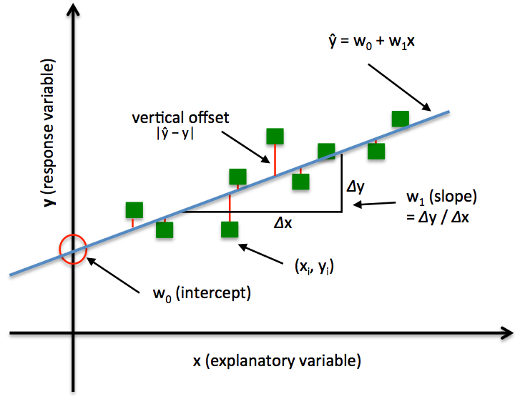
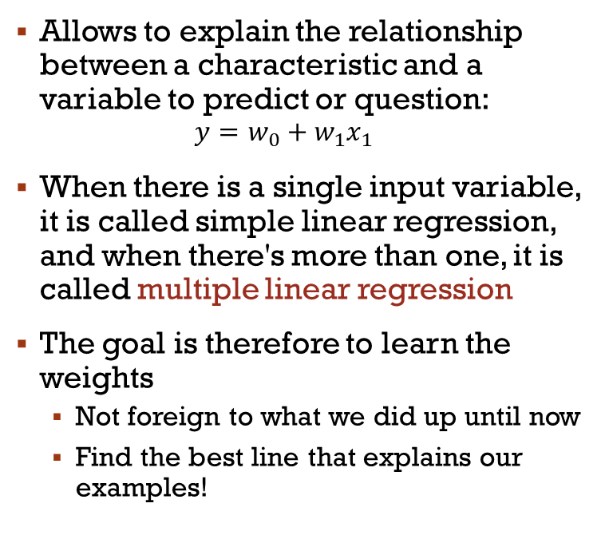
Linear Regression
Allows to explain the relationship between a characteristic and a variable to predict or question:
$$y=w_{0}+w_{1}x_{1}$$
When there is a single input variable, it is called simple linear regression, and when there's more than one, it is called multiple linear regression
The goal is therefore to learn the weights
Not foreign to what we did up until now
Find the best line that explains our examples!

Slide 5
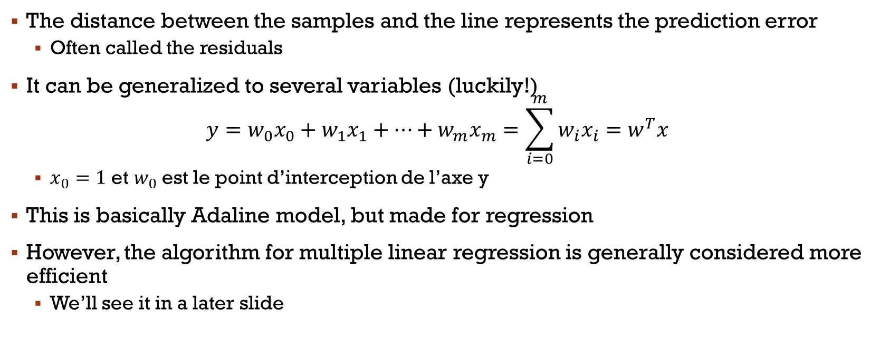
Multiple Linear regression
The distance between the samples and the line represents the prediction error
Often called the residuals
It can be generalized to several variables (luckily!)
$$y=w_{0}x_{0}+w_{1}x_{1}+…+w_{m}x_{m}=\sum_{i=0}^{m}{w_{i}x_{i}}=w^{T}x$$
$x_{0}=1$ et $w_{0}$ est le point d’interception de l’axe y
This is basically Adaline model, but made for regression
However, the algorithm for multiple linear regression is generally considered more efficient
We’ll see it in a later slide
Notes:
Produit scalaire entre le vecteur w et x
Multiple Linear Regression

Slide 6
Housing dataset
Let us use an example to work on regression: https://archive.ics.uci.edu/ml/machine-learning-databases/housing/
506 complete instances
CRIM per capita crime rate by town
ZN proportion of residential land zoned for lots over 25,000 sq.ft.
INDUS proportion of non-retail business acres per town
CHAS Charles River dummy variable (= 1 if tract bounds river; 0 otherwise)
NOX nitric oxides concentration (parts per 10 million)
RM average number of rooms per dwelling
AGE proportion of owner-occupied units built prior to 1940
DIS weighted distances to five Boston employment centres
RAD index of accessibility to radial highways
TAX full-value property-tax rate per $10,000
PTRATIO pupil-teacher ratio by town
B 1000(Bk - 0.63)^2 where Bk is the proportion of African American by town
LSTAT % lower status of the population
MEDV Median value of owner-occupied homes in $1000's (cible)
Notes:
La cible n’est pas obligatoire

Slide 7
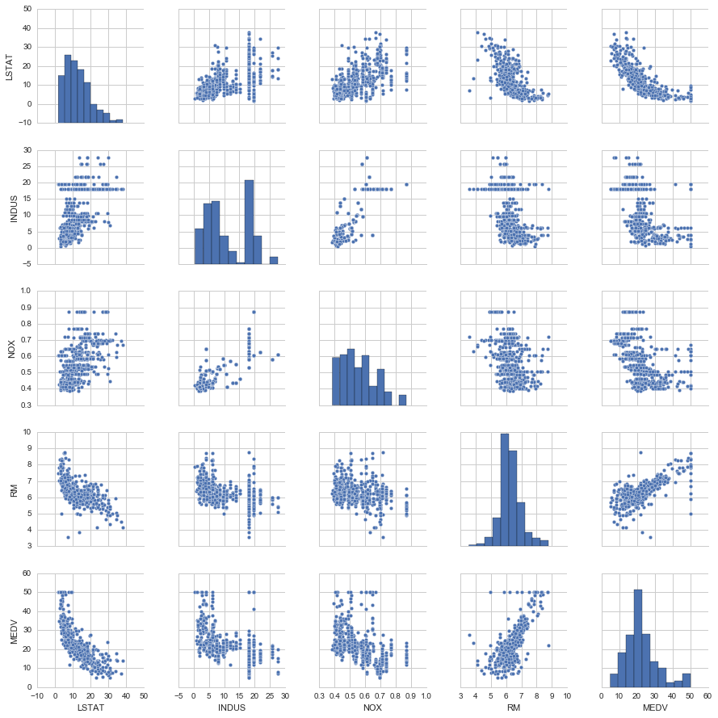
Housing Dataset

Slide 8
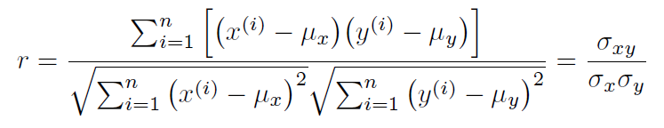
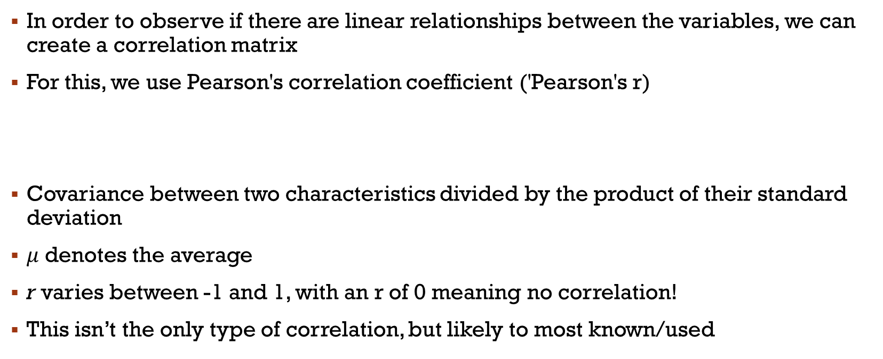
Observation of linear relationships
In order to observe if there are linear relationships between the variables, we can create a correlation matrix
For this, we use Pearson's correlation coefficient ('Pearson's r)
Covariance between two characteristics divided by the product of their standard deviation
$μ$ denotes the average
r varies between -1 and 1, with an r of 0 meaning no correlation!
This isn’t the only type of correlation, but likely to most known/used

Slide 9
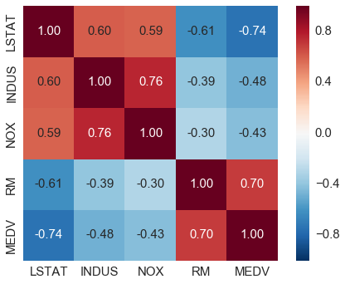
Example
Matplotlib - plt
Seaborn - sns
df = pd.read_csv('https://raw.githubusercontent.com/rasbt/python-machine-learning-book/master/code/datasets/housing/housing.data', header=None, sep='\s+')
cols = ['LSTAT', 'INDUS', 'NOX', 'RM', 'MEDV']
cm = np.corrcoef(df[cols].values.T)
sns.set(font_scale=1.5)
hm = sns.heatmap(cm, cbar=True, annot=True, square=True, fmt='.2f', annot_kws={'size': 15}, yticklabels=cols, xticklabels=cols)
plt.show()
Notes:
Parler de la matrice

Slide 10
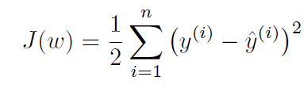
Ordinary Least Squares (OLS)
Estimation of the parameters of the line that minimizes the sum of the squared vertical distances from the line
Very similar to what we saw with Adaline, we need to minimize:
Grossly, the only difference with Adaline here is how the optimization problem is solved
For smaller problems, the parameters are estimated by the matrix inversion method
Otherwise, OLS can be implemented using numerical methods, especially when the number of features is too large for a closed-form solution

Slide 11
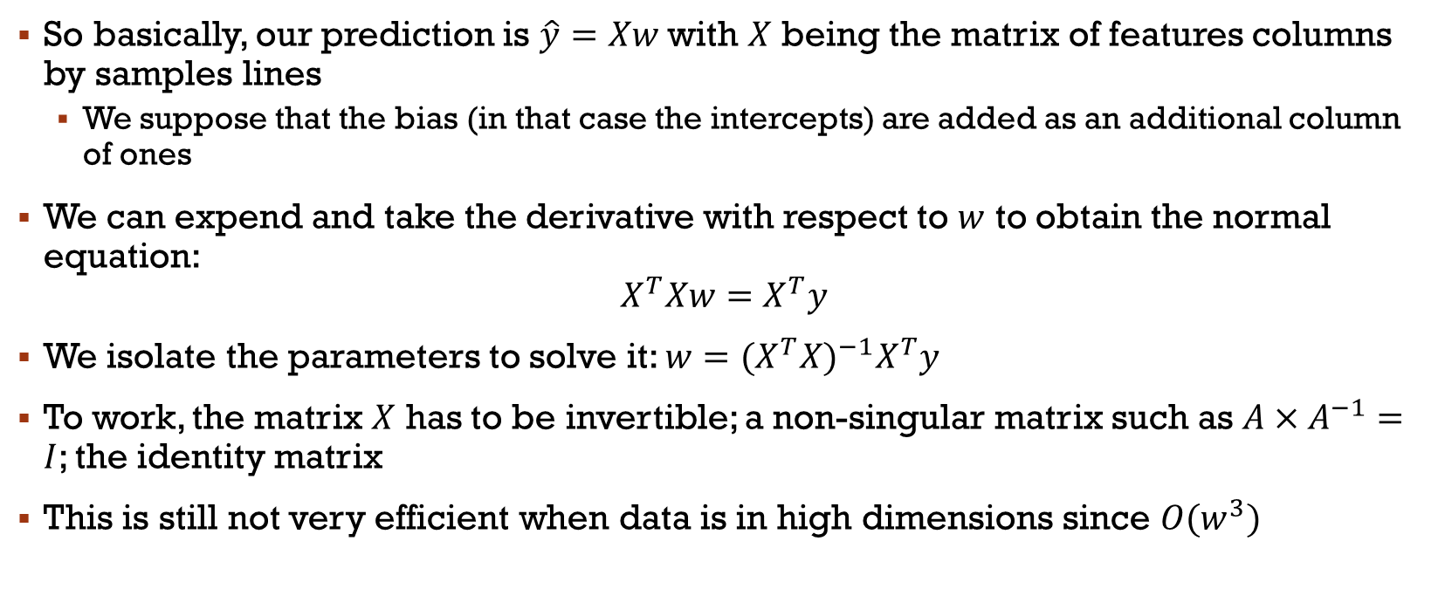
OLS using Matrix inversion
So basically, our prediction is $\hat{y}=Xw$ with $X$ being the matrix of features columns by samples lines
We suppose that the bias (in that case the intercepts) are added as an additional column of ones
We can expend and take the derivative with respect to $w$ to obtain the normal equation:
$$X^{T}Xw=X^{T}y$$
We isolate the parameters to solve it: $w={{(X}^{T}X)}^{−1}X^{T}y$
To work, the matrix $X$ has to be invertible; a non-singular matrix such as $A×A^{−1}=I$; the identity matrix
This is still not very efficient when data is in high dimensions since $O(w^{3})$
Notes:
Normal equations are equations obtained by setting equal to zero the partial derivatives of the sum of squared errors (least squares);

Slide 12
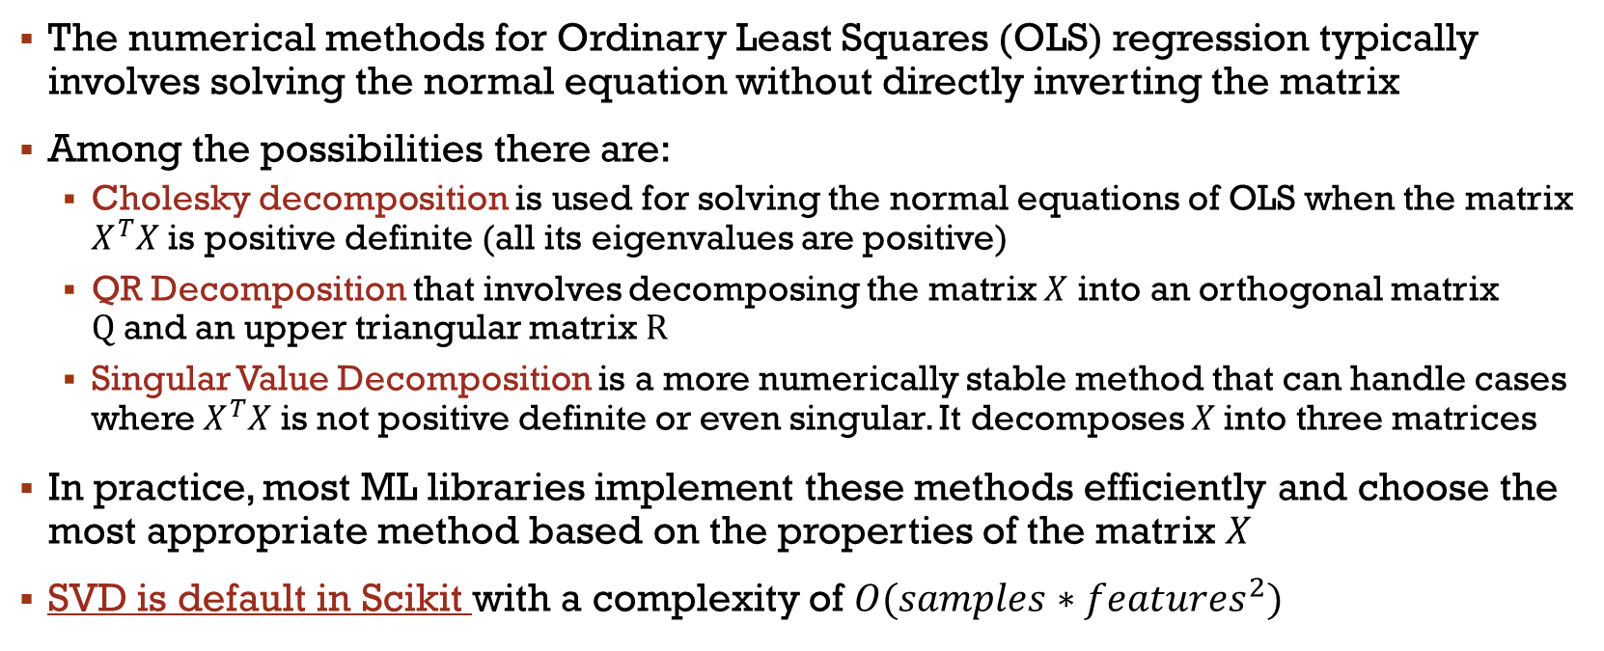
Numerical methods?
The numerical methods for Ordinary Least Squares (OLS) regression typically involves solving the normal equation without directly inverting the matrix
Among the possibilities there are:
Cholesky decomposition is used for solving the normal equations of OLS when the matrix $X^{T}X$ is positive definite (all its eigenvalues are positive)
QR Decomposition that involves decomposing the matrix $X$ into an orthogonal matrix $Q$and an upper triangular matrix $R$
Singular Value Decomposition is a more numerically stable method that can handle cases where $X^{T}X$ is not positive definite or even singular. It decomposes $X$into three matrices
In practice, most ML libraries implement these methods efficiently and choose the most appropriate method based on the properties of the matrix $X$
SVD is default in Scikit with a complexity of $O(samples∗{features}^{2})$

Slide 13
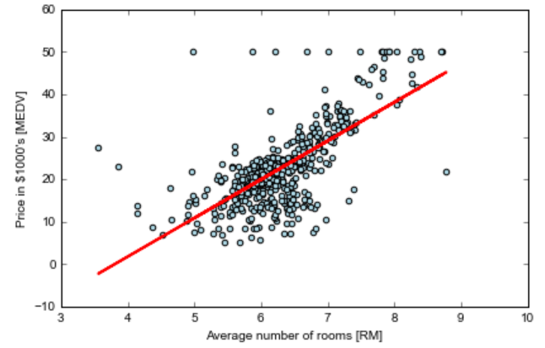
Regression between MEDV AND RM
from sklearn.linear_model import LinearRegression
slr = LinearRegression() slr.fit(X, y) y_pred = slr.predict(X)
plt.scatter(X, y, c='lightblue')
plt.plot(X, slr.predict(X), color='red', linewidth=2)
plt.xlabel('Average number of rooms [RM]')
plt.ylabel('Price in $1000\'s [MEDV]')
plt.tight_layout()
plt.show()
Print(slr.predict(5))
MEDV Median value of owner-occupied homes in $1000’s
RM average number of rooms per dwelling
10.840
Notes:
X peut être x1,…,xn

Slide 14
RanSac
Linear regressions are sensitive to outliers
With RANdom Sample Consensus, a random subset is selected to perform the regression (same idea as with bagging)
Select a random number of samples and compute the model
Test the other samples on the model
Add the samples that are within a distance 𝜀 from the model
Relearn on the new set
Estimate the total error
Finish if the performance is satisfactory, otherwise, start over at #1

Slide 15
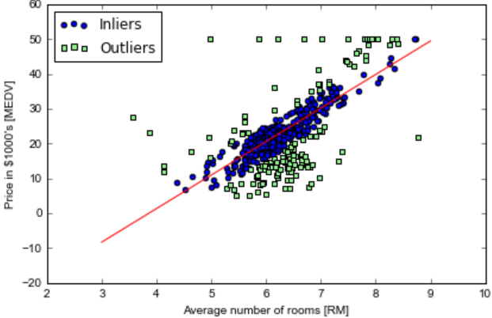
RANSAC
Here is a run of RANSAC in Scikit Learn on our previous dataset
Epoch max: 100, min random sample: 50, distance: 5
RANSAC doesn’t use the gradient, but many implementation call to OLS
It is a non-deterministic model estimation, since the model randomly select points to be part of the inliers
It uses the model trained on hypothetical inliers to predict all data
The worst (highest residuals) are then considered as the outliers for next cycle and so on

Slide 16
Theil-Sen
RANSAC produces a reasonable result in general; it is a simple, but efficient technique
In Scikit Learn, we can also find Theil-sen, a non-parametric estimator
It works by considering all possible pairs of points, calculating the slope between each pair, and then taking the median of these slopes as the estimate of the overall slope
It is slower than OLS and RANSAC, and worse if there is very few outliers
But better otherwise:
https://scikit-learn.org/stable/auto_examples/linear_model/plot_theilsen.html
Notes:
Theil-sen – check the chart

Slide 17
Huber Regressor
The Huber Regressor is based on the Huber loss function, which combines the properties of Mean Absolute Error (MAE) and Mean Squared Error (MSE)
Should be faster than RANSAC and Theil Sen unless the number of samples are large
This is because RANSAC and Theil Sen fit on smaller subsets of the data
It differs from Theil-Sen and RANSAC because it does not ignore the effect of the outliers but gives a lesser weight to them
It is a bit more complex, so we’ll skip the detail!

Slide 18
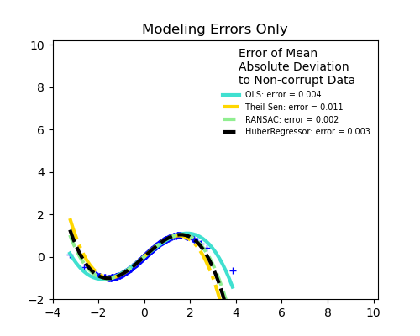
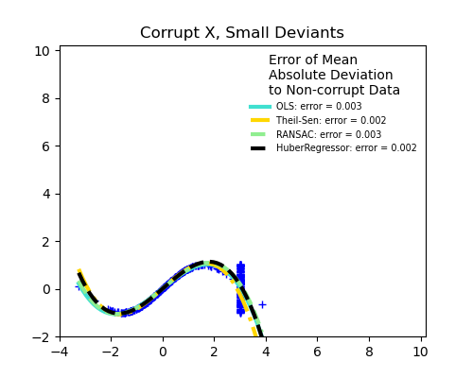
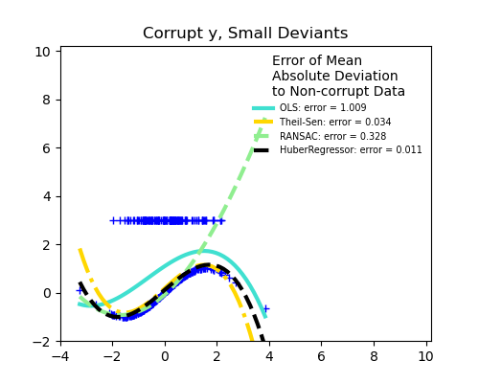
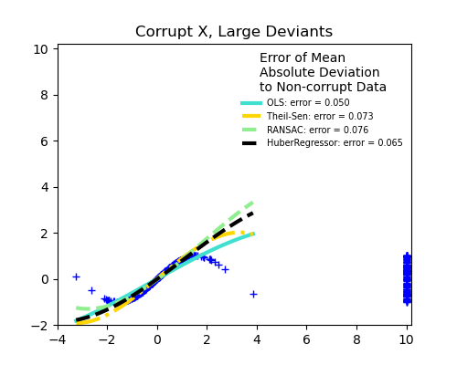
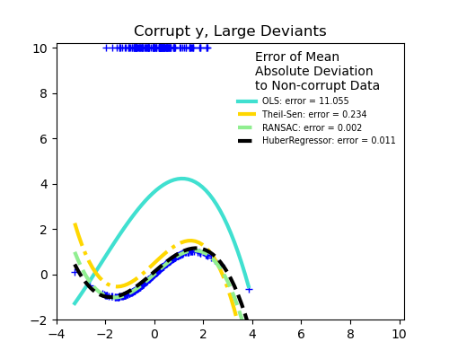
https://scikit-learn.org/stable/auto_examples/linear_model/plot_robust_fit.html
Notes:
Ok, but how come it isn’t linear? We’ll see later

Slide 19
Regularization

Slide 20
Regularization
Regularization in machine learning is a technique used to prevent overfitting
A model performs well on training data but poorly on unseen data
With regression, only a problem if we have outliers! (i.e: mathematical regression often has an exact solution)
The main idea is to introduce additional information (a penalty) to impose simplicity, smoothness, or other constraints on the model
We have briefly mentioned it with logistic regression and SVM
Popular methods:
Ridge Regression
Least Shrinkage and Selection Operator
Elastic Net

Slide 21

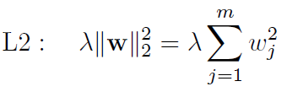

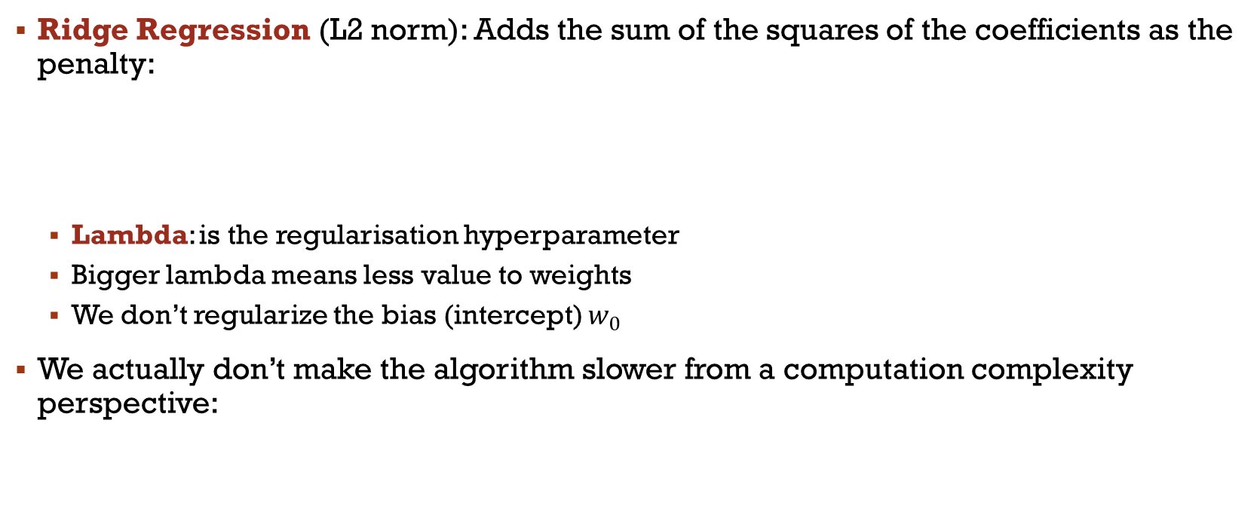
Regularization
Ridge Regression (L2 norm): Adds the sum of the squares of the coefficients as the penalty:
Lambda: is the regularisation hyperparameter
Bigger lambda means less value to weights
We don’t regularize the bias (intercept) $w_{0}$
We actually don’t make the algorithm slower from a computation complexity perspective:

Slide 22


Regularization
LASSO(L1 norm): adds the sum of the absolute values of the coefficients as the penalty to the loss function
It encourages sparsity, meaning it can lead to some coefficients being exactly zero
This is basically feature selection
https://scikit-learn.org/stable/modules/feature_selection.html#l1-feature-selection
If the dimensionality is much bigger than the number of training sample, many features are eliminated
Depending on gamma value too!

Slide 23
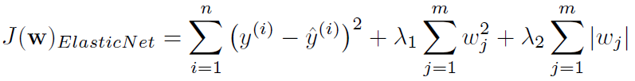

Regularization
Elastic Net: Both L1 and L2 regularization can be combined, which is useful when there are multiple correlated features.
L1 norm→ for high sparsity
L2 norm→ to select more features than LASSO
Useful when several attributes are correlated with each other
The implementation in Scikit Learn adds a ratio (hyperparameters)
Notes:
Tell them it is most common with neural net

Slide 24
Non-Linear regression
In reality, what we saw with SVM, the kernel trick, can be applied to pretty much any algorithm to turn them in a non-linear version
We’ll now talk a bit about additional options to do so

Slide 25
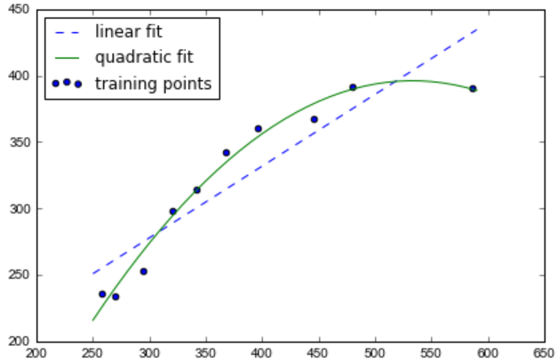
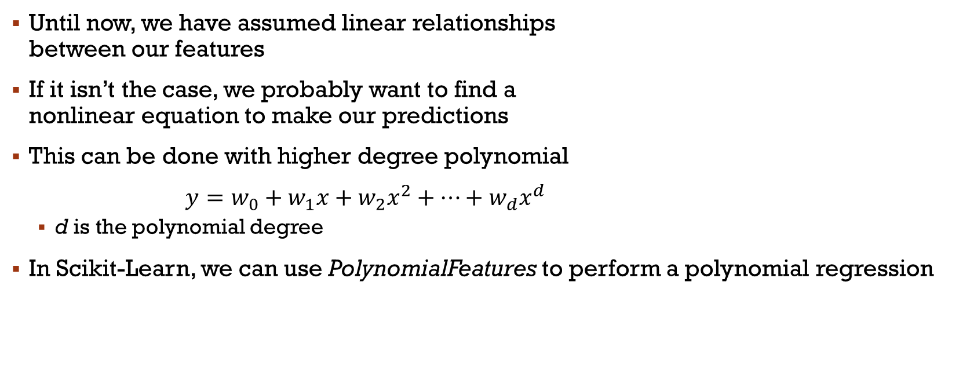
Polynomial regression
Until now, we have assumed linear relationships between our features
If it isn’t the case, we probably want to find a nonlinear equation to make our predictions
This can be done with higher degree polynomial
$y=w_{0}+w_{1}x+w_{2}x^{2}+…+w_{d}x^{d}$
d is the polynomial degree
In Scikit-Learn, we can use PolynomialFeatures to perform a polynomial regression
Notes:
Voir exemple de code

Slide 26
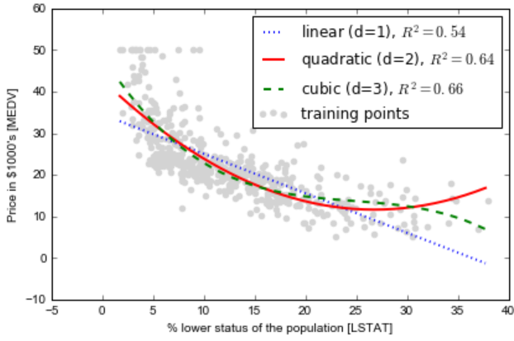
Polynomial regression
Let us look at the sample code from “Housing – polynomial”
What are our conclusions regarding that code?
Notes:
Choix, + simple, sinon overfitting
R^2: Coefficient de détermination

Slide 27

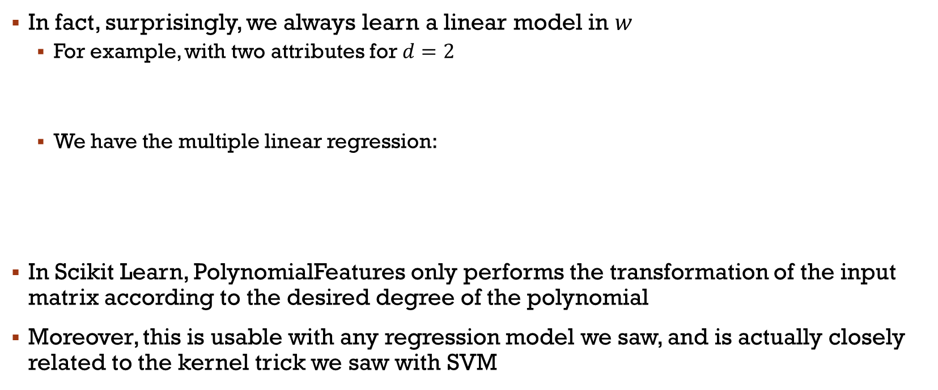
Polynomial regression
In fact, surprisingly, we always learn a linear model in $w$
For example, with two attributes for $d=2$
We have the multiple linear regression:
In Scikit Learn, PolynomialFeatures only performs the transformation of the input matrix according to the desired degree of the polynomial
Moreover, this is usable with any regression model we saw, and is actually closely related to the kernel trick we saw with SVM

Slide 28
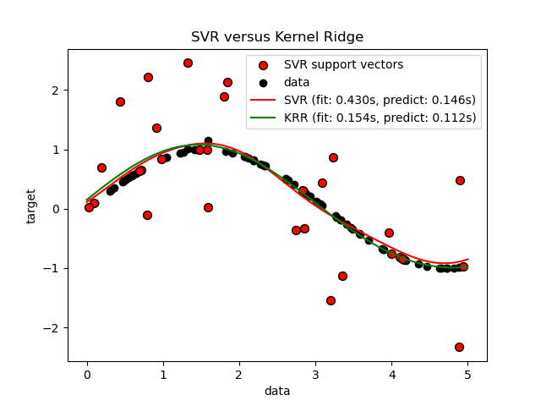
Kernel ridge regression
Kernel Ridge Regression (KRR) is an algorithm used in machine learning that combines ridge regression
KernelRidge is identical to SVR, however, different loss functions are used
KRR uses squared error loss
KRR is often faster on smaller datasets
KRR learnt model is non-sparse (few zeroes) and is, therefore, slower

Slide 29



Classification and Regression Trees
The CART algorithm supports regressions in addition to classification
To use it in Scikit-Learn, we call DecisionTreeRegressor
The main modification consists of replacing the impurity measure with the mean squared error (MSE)
x: feature, D: dataset, N: samples
with
Notes:
IG= Gain

Slide 30
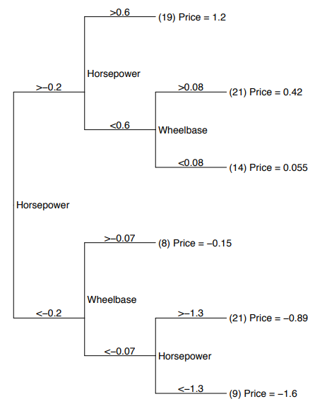
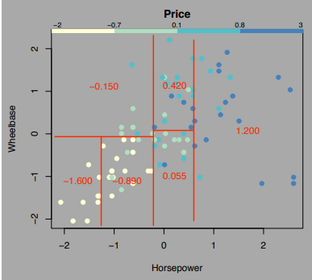
Example

Slide 31
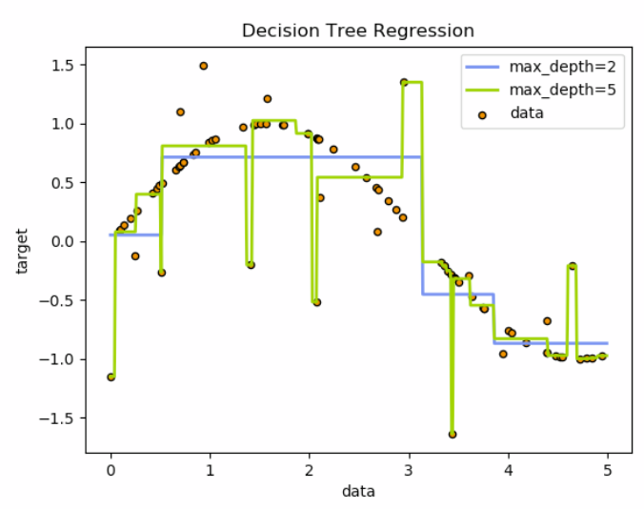
Exemple 2
https://scikit-learn.org/stable/auto_examples/tree/plot_tree_regression.html#sphx-glr-auto-examples-tree-plot-tree-regression-py
Notes:
Discussion?

Slide 32
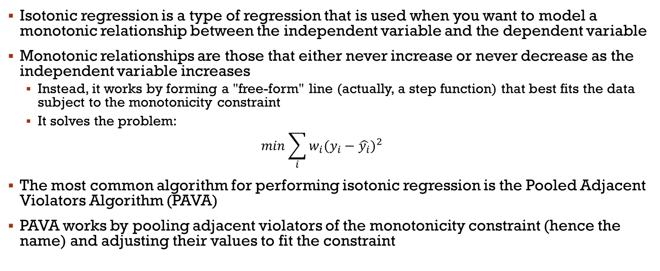
Isotonic Regression
Isotonic regression is a type of regression that is used when you want to model a monotonic relationship between the independent variable and the dependent variable
Monotonic relationships are those that either never increase or never decrease as the independent variable increases
Instead, it works by forming a "free-form" line (actually, a step function) that best fits the data subject to the monotonicity constraint
It solves the problem:
$$min\sum_{i}{w_{i}{(y_{i}−\hat{y_{i}})}^{2}}$$
The most common algorithm for performing isotonic regression is the Pooled Adjacent Violators Algorithm (PAVA)
PAVA works by pooling adjacent violators of the monotonicity constraint (hence the name) and adjusting their values to fit the constraint

Slide 33
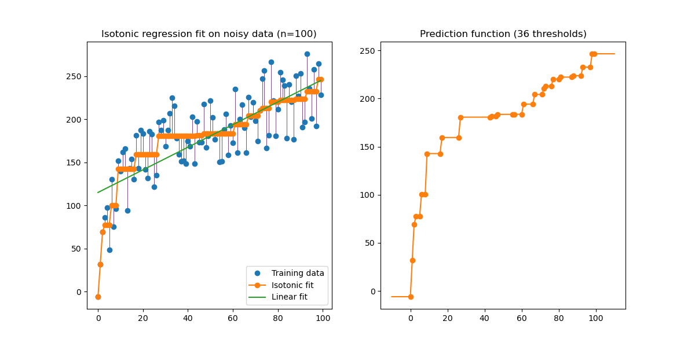
Isotonic Regression

Slide 34
Isotonic Regression
Isotonic regression is used for nonmetric multidimensional scaling, where a low-dimensional embedding for data points is sought such that order of distances between points in the embedding matches order of dissimilarity between point
We’ll see better method to do so, however
Isotonic regression is also used in probabilistic classification to calibrate the predicted probabilities of supervised ML models
Calibration refers to the process of adjusting the predicted probabilities to better reflect the true likelihood of the outcomes
Well-calibrated probabilities should represent the true probability of the event of interest
Basically, we train an isotonic regression model to adjust the predicted probabilities to the real probabilities
Then, the model is used to map the original predicted probabilities to new, calibrated probabilities

Slide 35
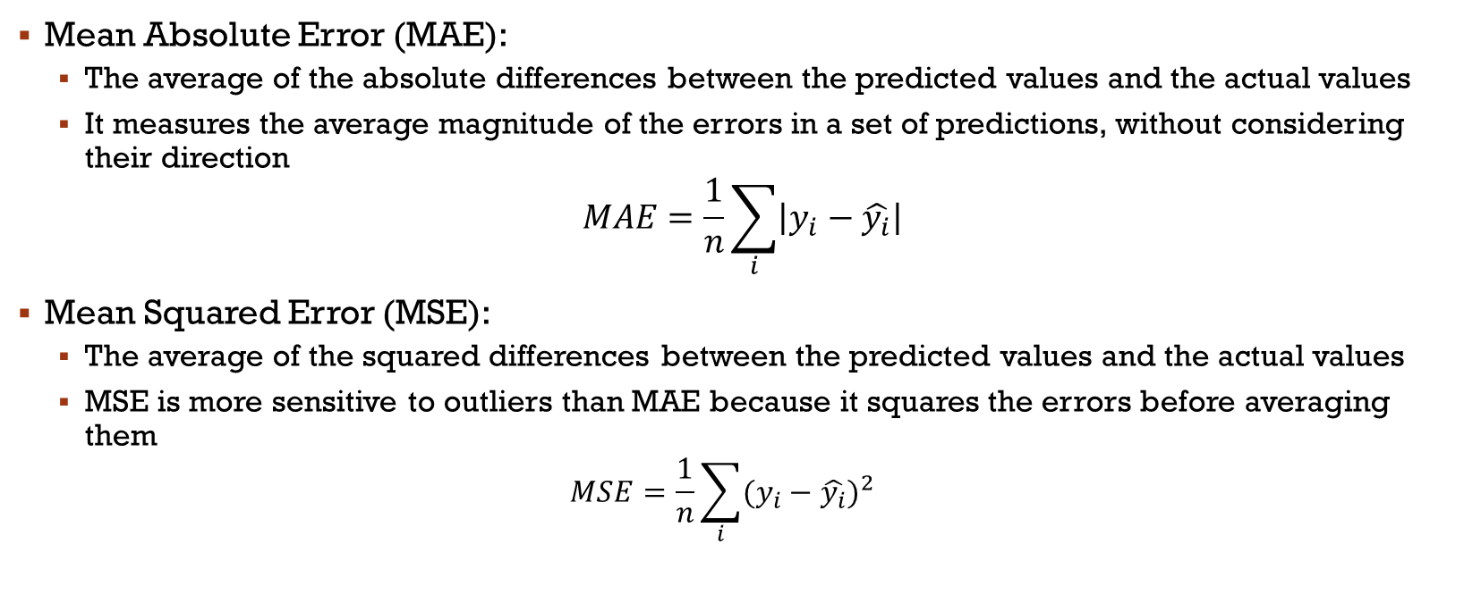
Common evaluation measures
Mean Absolute Error (MAE):
The average of the absolute differences between the predicted values and the actual values
It measures the average magnitude of the errors in a set of predictions, without considering their direction
$$MAE=\frac{1}{n}\sum_{i}{\left|y_{i}−\hat{y_{i}}\right|}$$
Mean Squared Error (MSE):
The average of the squared differences between the predicted values and the actual values
MSE is more sensitive to outliers than MAE because it squares the errors before averaging them
$$MSE=\frac{1}{n}\sum_{i}{{(y_{i}−\hat{y_{i}})}^{2}}$$

Slide 36
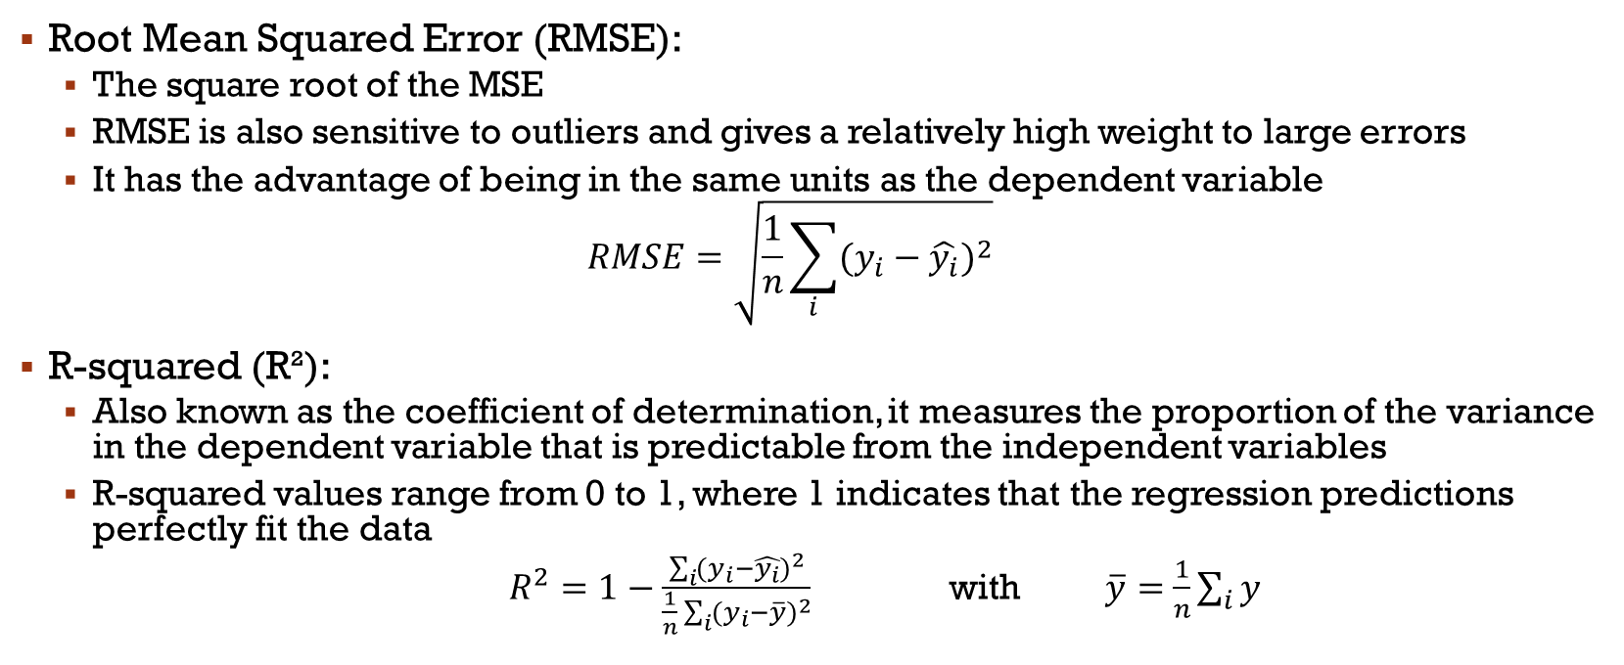
Common evaluation measures
Root Mean Squared Error (RMSE):
The square root of the MSE
RMSE is also sensitive to outliers and gives a relatively high weight to large errors
It has the advantage of being in the same units as the dependent variable
$$RMSE=\sqrt{\frac{1}{n}\sum_{i}{{(y_{i}−\hat{y_{i}})}^{2}}}$$
R-squared (R²):
Also known as the coefficient of determination, it measures the proportion of the variance in the dependent variable that is predictable from the independent variables
R-squared values range from 0 to 1, where 1 indicates that the regression predictions perfectly fit the data
$R^{2}=1−\frac{\sum_{i}{{(y_{i}−\hat{y_{i}})}^{2}}}{\frac{1}{n}\sum_{i}{{(y_{i}−\overline{y})}^{2}}}$ with $\overline{y}=$ $\frac{1}{n}\sum_{i}{y}$

Slide 37
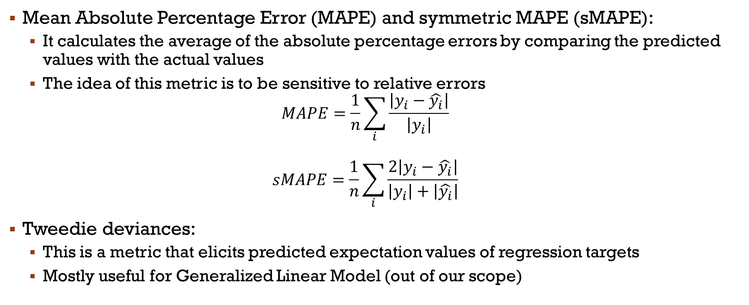
Common evaluation measures
Mean Absolute Percentage Error (MAPE) and symmetric MAPE (sMAPE):
It calculates the average of the absolute percentage errors by comparing the predicted values with the actual values
The idea of this metric is to be sensitive to relative errors
$$MAPE=\frac{1}{n}\sum_{i}{\frac{\left|y_{i}−\hat{y_{i}}\right|}{\left|y_{i}\right|}}$$ $$sMAPE=\frac{1}{n}\sum_{i}{\frac{2\left|y_{i}−\hat{y_{i}}\right|}{\left|y_{i}\right|+\left|\hat{y_{i}}\right|}}$$
Tweedie deviances:
This is a metric that elicits predicted expectation values of regression targets
Mostly useful for Generalized Linear Model (out of our scope)

Slide 38
Conclusion
Les régressions sont très utiles pour faire des prédictions en termes de variables continues
D’autres algorithmes peuvent être utilisés pour cette tâche (SVM, Random Forest, mais aussi modèles Bayésien)
De plus, les régressions de différents degrés peuvent être utiles pour d’autres problèmes d’analyse de données (avec ou sans ML)
Le coefficient de détermination ($R^{2}$) est la méthode favorite d’évaluation des modèles de régressions
Pour la régression linéaire, c’est simplement la corrélation au carrée

Slide 39
Main References
Russell S., Norvig P., Artificial Intelligence: A Modern Approach. Prentice-Hall, Englewood Cliffs, 2021.
Aggarwal, C. C., Neural networks and deep learning. Springer, 2023.
Goodfellow I., Bengio Y., Deep Learning. The MIT Press, 2016.
Raschka S., Python Machine Learning, Packt Publishing, 2015.
Sutton R.S., Barto A.G., Reinforcement Learning: An Introduction, A Bradford Book, 2021.
Witten I.H., Frank E., Hall M.A., Pal C. Data Mining: Practical Machine Learning Tools and Techniques, Morgan Kaufmann, 2016.

